Slide 1
Evaluating Password Strength
Patrick Routh
November, 2019

Slide 2
What is a Password?
Word or phrase that is used as an authentication or authorization tool to gain access to data
How do I create a strong password?
Password strength - numerically expressed measure of how uncrackable a password is
Two major factors: length and complexity
Length
Complexity
Example: Password of length 6
(96 possible characters) ^ 6 total characters = 7.8 x 10^11 = 7,800,000,000,000 combinations

Slide 3
Brute-Force Analysis
Password Length | All Characters | Only Lowercase
3 characters | 0.86 minutes | 0.02 seconds
4 characters | 1.36 minutes | 0.046 seconds
5 characters | 2.15 hours | 11.9 seconds
6 characters | 8.51 days | 5.15 minutes
7 characters | 2.21 years | 2.23 hours
8 characters | 2.1 centuries | 2.42 days
9 characters | 20 millennia | 2.07 months
10 characters | 1,899 millennia | 4.48 years
11 characters | 180,365 millennia | 1.16 centuries
12 characters | 17,184,705 millennia | 3.03 millennia
13 characters | 1,627,797,068 millennia | 78.7 millennia
14 characters | 154,640,721,434 millennia | 2,046 millennia

Slide 4
Online Password Checkers
My1Login
PasswordMeter
JavaScript
LastPass
Thycotic
Comparitech

Slide 5
Minimum of 8 characters
Change passwords every 90 days
No personal identifiers
Never repeat a password
Avoid simple dictionary words
Include numbers and special characters! (!@#$%^&*)

Slide 6
Analyzing Real Passwords
Data Breaches and Data Leaks
Havibeenpwned – 500+ million compromised passwords
217,626
32%
Letters only
BAD
388,720
57%
142,370
21%
Numbers only
677,566
28,724
4%
< 6 characters
GOOD
390
0.0006%
FINE
273,339
41%
6+ characters
Numbers
Letters
BEST
126
0.0002%
Notes:
Analysis – unlabeled dataset - 677,566 total passwords
Password Length
Average: 7.23 characters
Min: 1
Max: 27
Analysis – labeled dataset – 65,534 total passwords
Password Length
Average: 9.98 characters
Min: 2
Max: 220

Slide 7
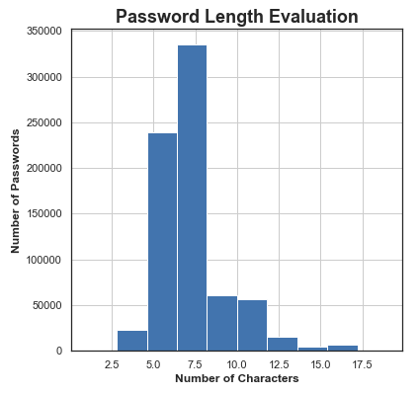
Password Length Distribution
Notes:
All data – both labeled and unlabeled

Slide 8
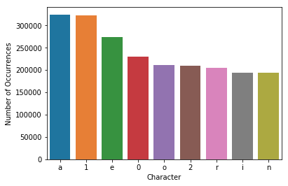
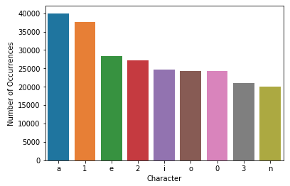
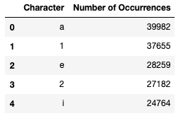
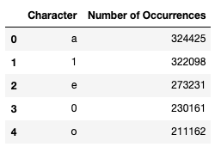
Unlabeled Dataset
Labeled Dataset
Character Frequency Distribution

Slide 9
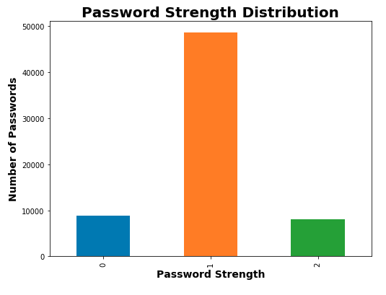
Assigning a Value to Assess Strength
Labelled Dataset
65,534 passwords
Password Length
Average: 9.98 characters
Min: 2
Max: 220
Password Strength
0 - 8801
1 - 48653
2 - 8080

Slide 10
Machine Learning Classification Results
Model | Base Model | Base Model Test Accuracy | Prediction Accuracy | Ratio of Labeled:Unlabeled | Number of Classified Observations
Logistic Regression | LR | 100% | 54% | N/A | 131,068
Random Forest | RF | 100% | 40% | N/A | 131,068
XGBoost | XGB | 100% | 40% | N/A | 131,068
NN Model 1 | NN Model 1 | 88.07% | 44.46% | N/A | 131,068
NN Model 2 | NN Model 1 | 88.07% | 23.05% | 1:1 | 169,900
NN Model 3 | NN Model 1 | 88.07% | 66.60% | 1:1/3 | 82,928
NN Model 4 | NN Model 1 | 88.07% | 59.57% | 1:1/2 | 91,625
NN Model 5 | NN Model 3 | 66.60% | 51.18% | 1:1/4 | 82,928
NN Model 6 | NN Model 1 | 88.07% | 75.72% | 1:1/4 | 74,231
NN Model 7 | NN Model 6 | 75.72% | 64.28% | 1:1/4 | 82,928
NN Model 8 | NN Model 6 | 64.28% | 54.27% | 1:1/4 | 91,625
More data = less accuracy
Logistic Regression performed the best
Model | Pred Acc | # Data Points
LR | 54% | 131,068
NN Model 1 | 44.46% | 131,068

Slide 11
Advancements in Security Authentication Protocols
Multi-Factor
Biometrics-based
Continuous User Behavior
Blockchain
Quantum Technologies

